Slide 1
Presentation Title
Subtitle or name of presenter

Slide 2
Overview
Problem Overview:
Modern autonomy technology relies on GPS for precise positioning
String of vehicles, or platoons, rely on differential GPS for precise ranging
This method of moving differential GPS is called Dynamic Base Real Time Kinematic Positioning (DRTK)
Obstructions such as bridges or building can cause GPS outages and loss of carrier phase integer ambiguities.
Goal:
Can RADAR be used to estimate the RPV and integer ambiguities in the absence of GPS?

Slide 3
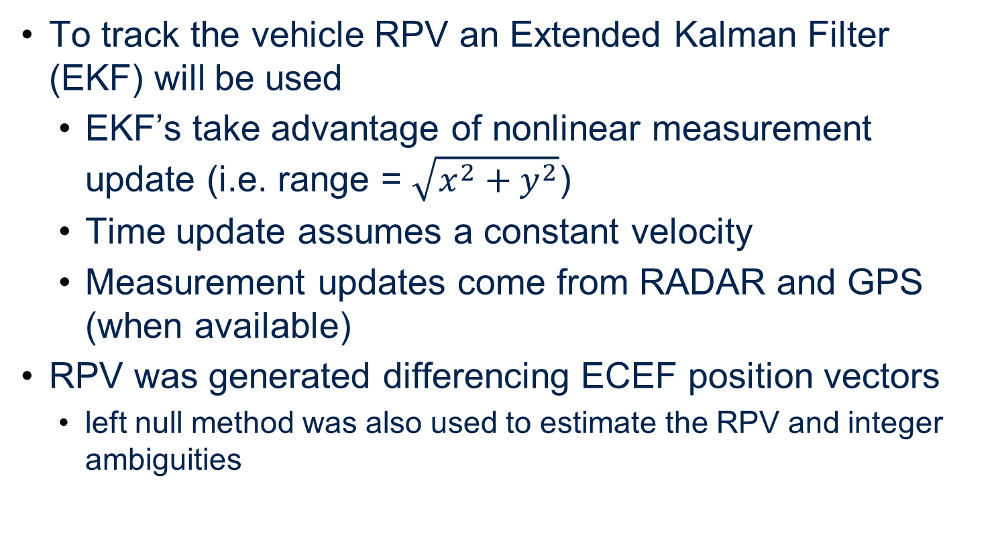
Methodology
To track the vehicle RPV an Extended Kalman Filter (EKF) will be used
EKF’s take advantage of nonlinear measurement update (i.e. range = $\sqrt{x^{2}+y^{2}}$)
Time update assumes a constant velocity
Measurement updates come from RADAR and GPS (when available)
RPV was generated differencing ECEF position vectors
left null method was also used to estimate the RPV and integer ambiguities

Slide 4
GPS Data

Slide 5
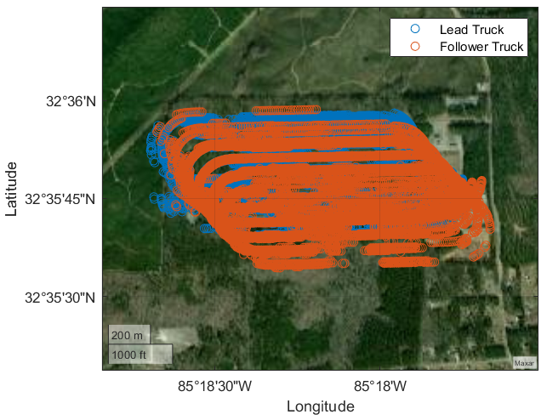
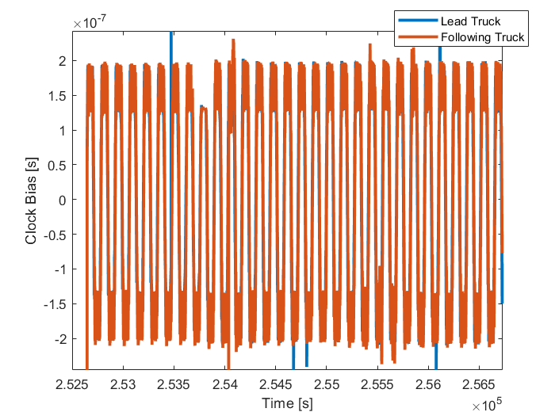
Position Solution from Observables
Timing errors caused the position solution to be in the right shape, but biased from true position

Slide 6
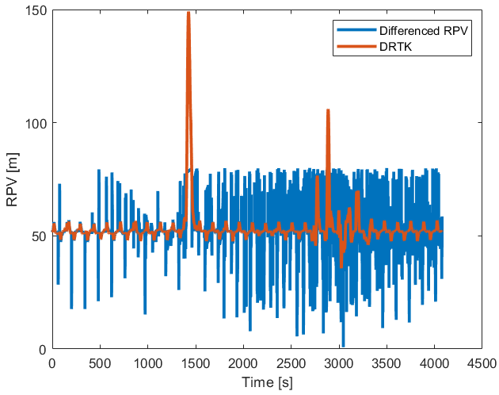
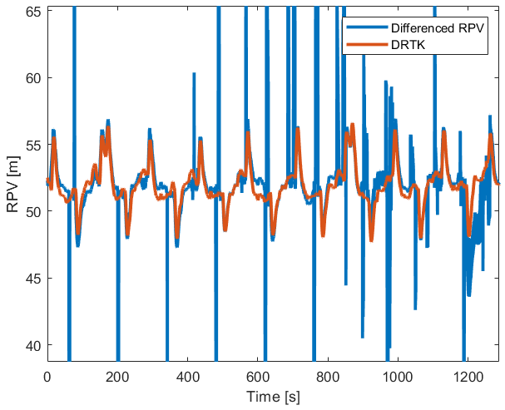
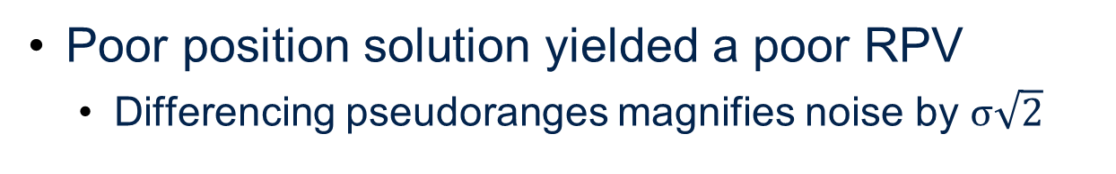
RPV from Differenced Pseudoranges
Poor position solution yielded a poor RPV
Differencing pseudoranges magnifies noise by $σ\sqrt{2}$

Slide 7
RPV from Left Null Method

Slide 8
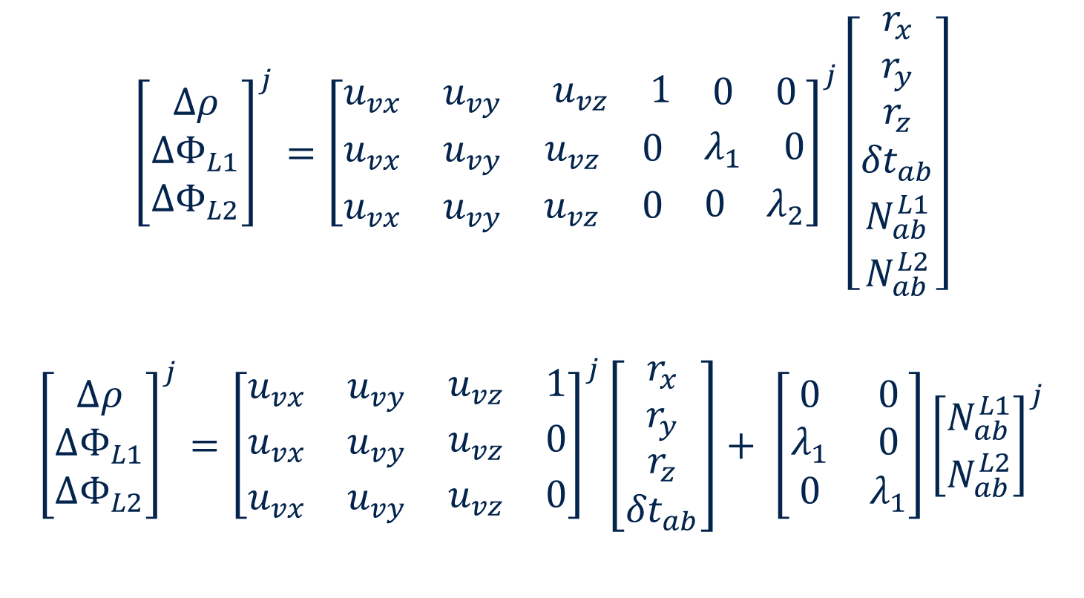
Left Null Method
$${\left[\begin{matrix}∆ρ \\ {∆Φ}_{L1} \\ {∆Φ}_{L2}\end{matrix}\right]}^{j}={\left[\begin{matrix}u_{vx} & u_{vy} & \begin{matrix}u_{vz} & 1 & \begin{matrix}0 & 0\end{matrix}\end{matrix} \\ u_{vx} & u_{vy} & \begin{matrix}u_{vz} & 0 & \begin{matrix}λ_{1} & 0\end{matrix}\end{matrix} \\ u_{vx} & u_{vy} & \begin{matrix}u_{vz} & 0 & \begin{matrix}0 & λ_{2}\end{matrix}\end{matrix}\end{matrix}\right]}^{j}\left[\begin{matrix}r_{x} \\ r_{y} \\ \begin{matrix}r_{z} \\ {δt}_{ab} \\ \begin{matrix}N_{ab}^{L1} \\ N_{ab}^{L2}\end{matrix}\end{matrix}\end{matrix}\right]$$
$${\left[\begin{matrix}∆ρ \\ {∆Φ}_{L1} \\ {∆Φ}_{L2}\end{matrix}\right]}^{j}={\left[\begin{matrix}u_{vx} & u_{vy} & \begin{matrix}u_{vz} & 1\end{matrix} \\ u_{vx} & u_{vy} & \begin{matrix}u_{vz} & 0\end{matrix} \\ u_{vx} & u_{vy} & \begin{matrix}u_{vz} & 0\end{matrix}\end{matrix}\right]}^{j}\left[\begin{matrix}r_{x} \\ r_{y} \\ \begin{matrix}r_{z} \\ {δt}_{ab}\end{matrix}\end{matrix}\right]+ \left[\begin{matrix}0 & 0 \\ λ_{1} & 0 \\ 0 & λ_{1}\end{matrix}\right]{\left[\begin{matrix}N_{ab}^{L1} \\ N_{ab}^{L2}\end{matrix}\right]}^{j}$$

Slide 9
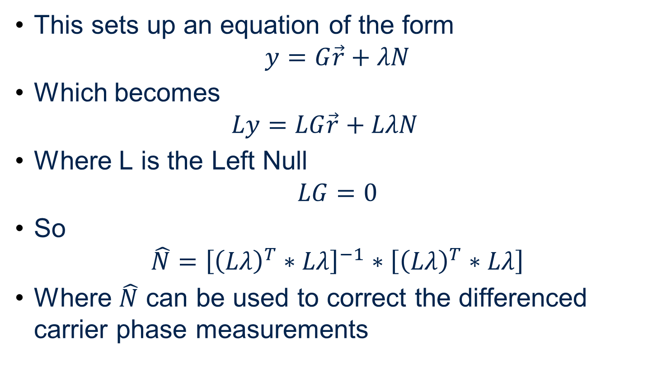
Left Null Method Cont.
This sets up an equation of the form
$$y=G\vec{r}+λN$$
Which becomes
$$Ly=LG\vec{r}+LλN$$
Where L is the Left Null
$$LG=0$$
So
$$\hat{N}={\left[{\left(Lλ\right)}^{T}∗Lλ\right]}^{−1}∗\left[{\left(Lλ\right)}^{T}∗Lλ\right]$$
Where $\hat{N}$ can be used to correct the differenced carrier phase measurements

Slide 10
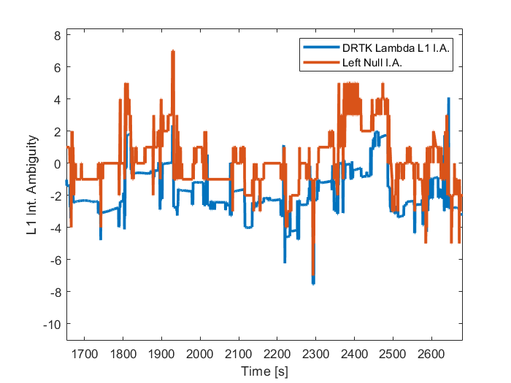
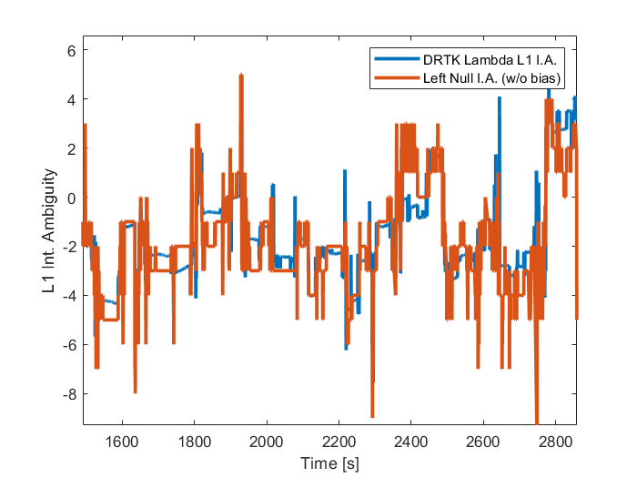
Left Null Integer Ambiguities
Improper formatting of left null program resulted in a single average integer ambiguity output

Slide 11
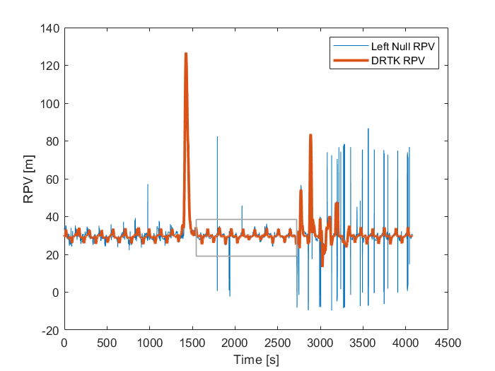
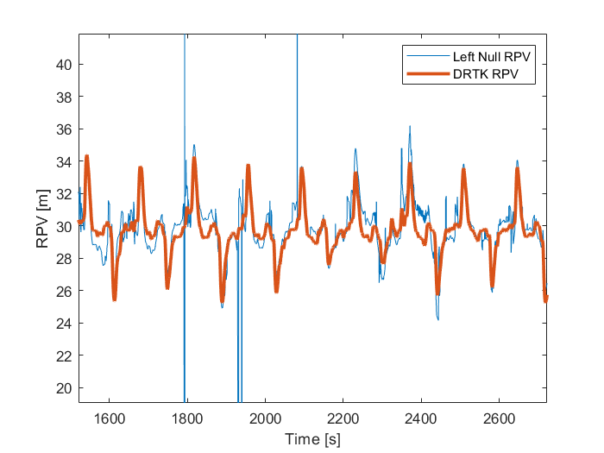
Left Null Carrier Phase Solution
Using the integer outputs still results in a cleaner carrier phase RPV

Slide 12
Centralized Range/GPS Kalman Filter

Slide 13


EKF Overview
Estimating the state of a two-vehicle platoon using GPS and automotive radar
GPS position, relative range measurements

Slide 14
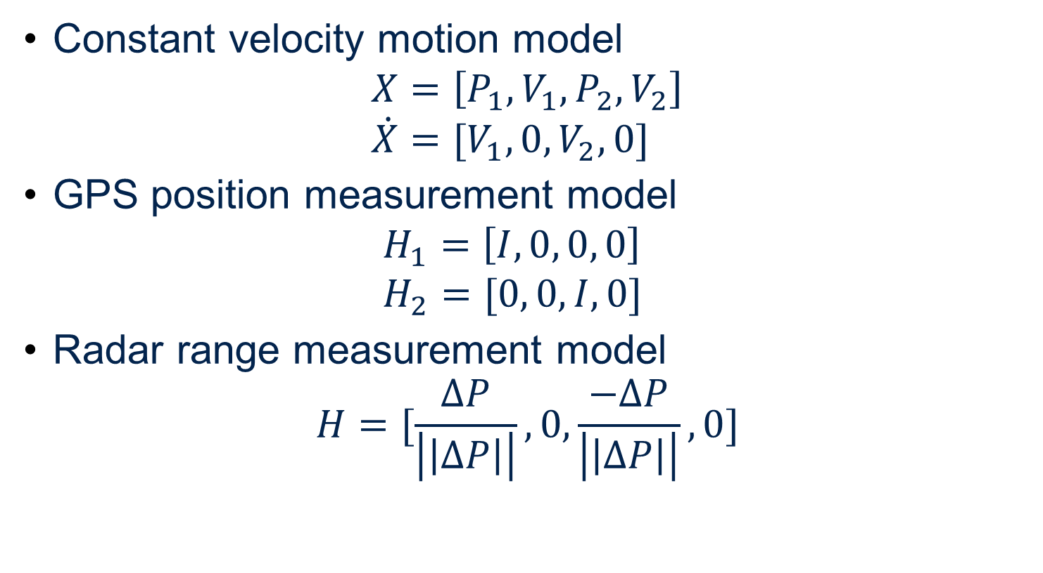
EKF Equations
Constant velocity motion model $X=\left[P_{1},V_{1},P_{2},V_{2}\right]$ $\dot{X}=[V_{1},0, V_{2},0]$
GPS position measurement model $H_{1}=\left[I, 0, 0, 0\right]$ $H_{2}=[0, 0, I, 0]$
Radar range measurement model $H=[\frac{ΔP}{\left|\left|ΔP\right|\right|}, 0,\frac{−ΔP}{\left|\left|ΔP\right|\right|}, 0]$

Slide 15
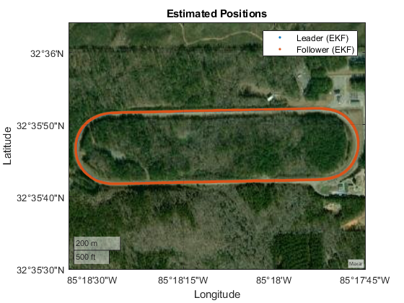
Nominal EKF Results
* Using output of Novatel for GPS measurements

Slide 16
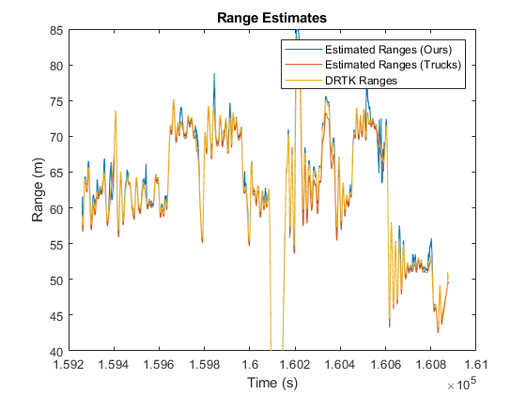
Nominal EKF Results

Slide 17
Integer Fixing Through Range Estimates

Slide 18
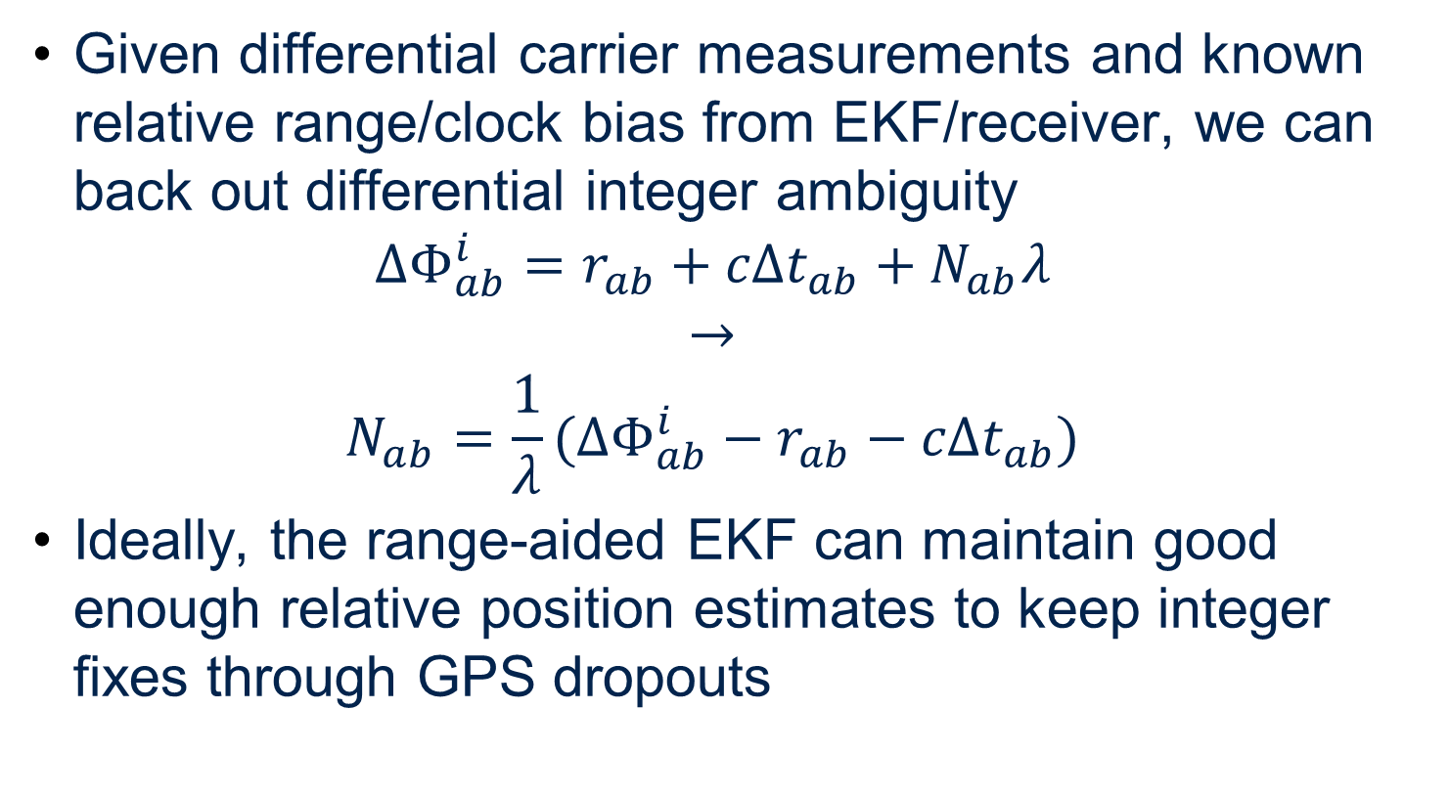
Backing Out Integers
Given differential carrier measurements and known relative range/clock bias from EKF/receiver, we can back out differential integer ambiguity $ΔΦ_{ab}^{i}=r_{ab}+cΔt_{ab}+N_{ab}λ$ $→$ $N_{ab}=\frac{1}{λ}(ΔΦ_{ab}^{i}−r_{ab}−cΔt_{ab})$
Ideally, the range-aided EKF can maintain good enough relative position estimates to keep integer fixes through GPS dropouts

Slide 19
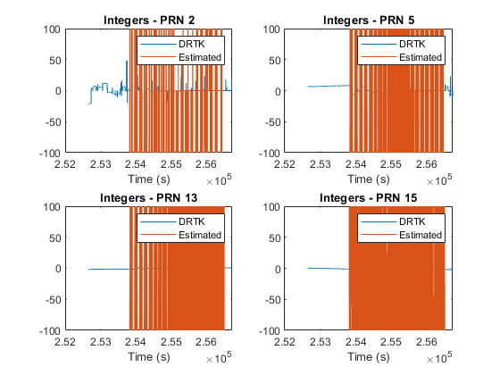
Testing ☹
* Using our relative position estimates

Slide 20
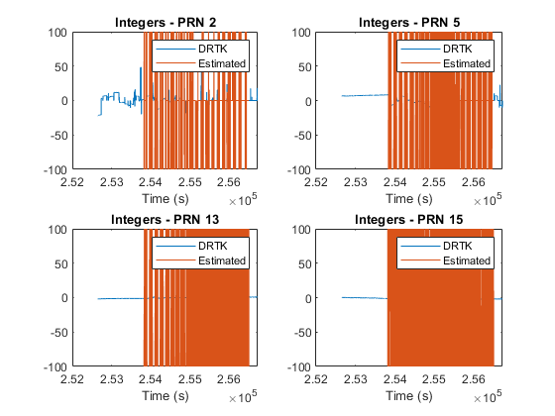
Testing ☹
* Using DRTK relative position estimates and
Novatel positions

Slide 21

Possible Error Sources
$$N_{ab}=\frac{1}{λ}(ΔΦ_{ab}^{i}−r_{ab}−cΔt_{ab})$$

Slide 22
Questions?
Thank you!

